Slide 1
Introduction on CQL
By Dr Elisavet Andrikopoulou

Slide 2

Agenda
What is CQL and how does it connect with FHIR?
CQL Example Library
Upload CQL Library to FHIR server
Please click on the repository to find all sample code and examples of both FHIR and CQL.

Slide 3
CQL
Clinical Quality Language (CQL) is a high-level, domain-specific language focused on clinical quality and targeted at measure and decision support artefact authors.
A CQL artifact is referred to as a library.
For simplicity, libraries in CQL correspond directly with a single file.
A CQL Library may be broken down into two parts:
Declarations
Statements

Slide 4
Basic CQL Syntax
Library
Data Model
Dependencies
Terminologies
Context
Definitions

Slide 5
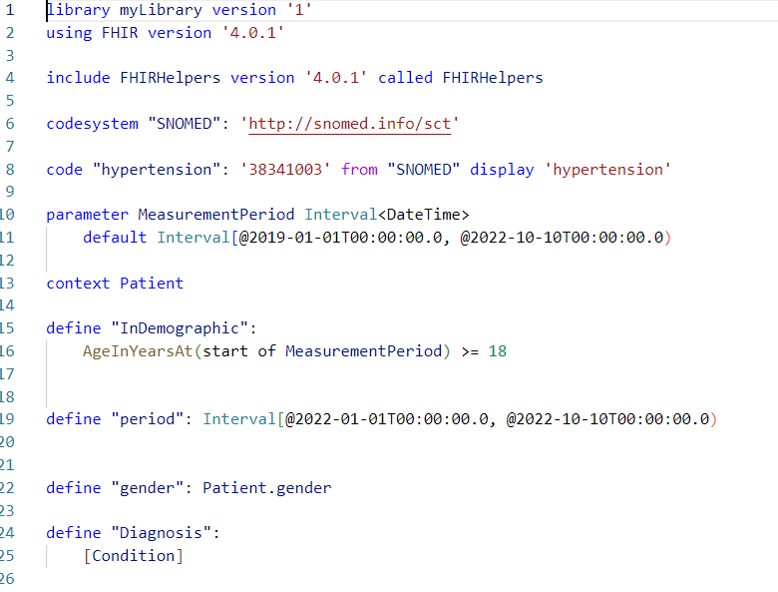

Slide 6
Basic CQL Syntax
Please click on the repository to find all sample code and examples of both FHIR and CQL and continue the tutorial.

Slide 7
Upload CQL Library to FHIR Server
Convert CQL file to base-64 string (e.g. https://www.base64decode.org/)
Create a FHIR Library Resource see Resource Library
Upload FHIR Library Resource to FHIR server

Slide 8
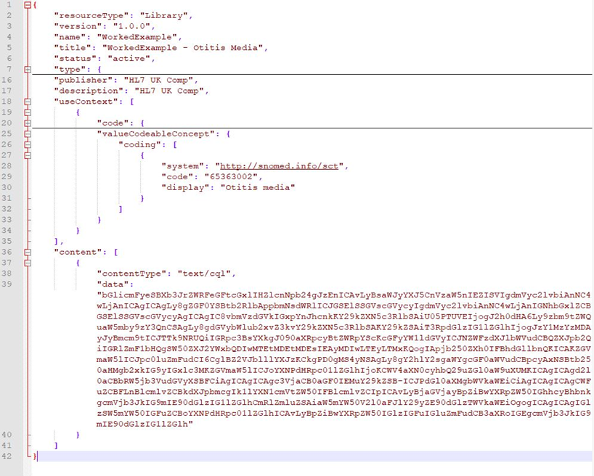
Create a FHIR Library Resource
JSON document
Specify the use context!!!
Specify the the contentType of library (in this case ‘text/cql’)
Provide content of the library (data):
Copy and paste encoded CQL file in base-64 string e.g. https://www.base64decode.org/
Example of FHIR Library Resource containing encoded CQL Library

Slide 9
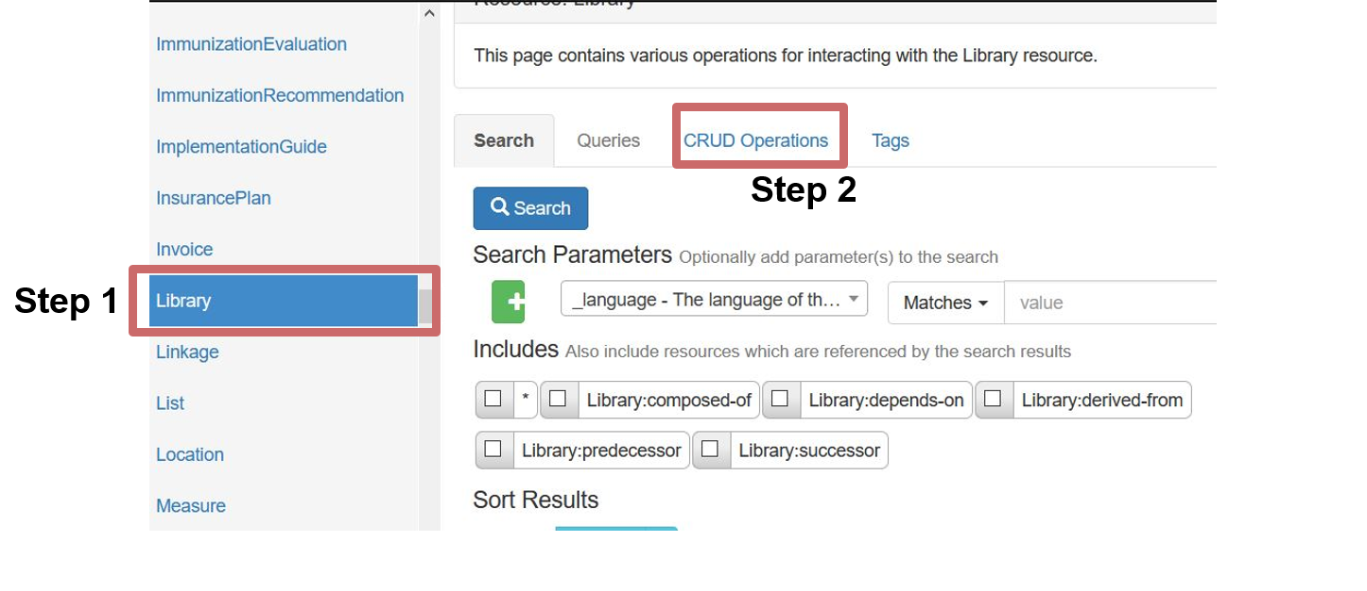
Upload CQL Library to Hapi FHIR
Select Library from the list of Resources (left panel)
Navigate to CRUD operations

Slide 10
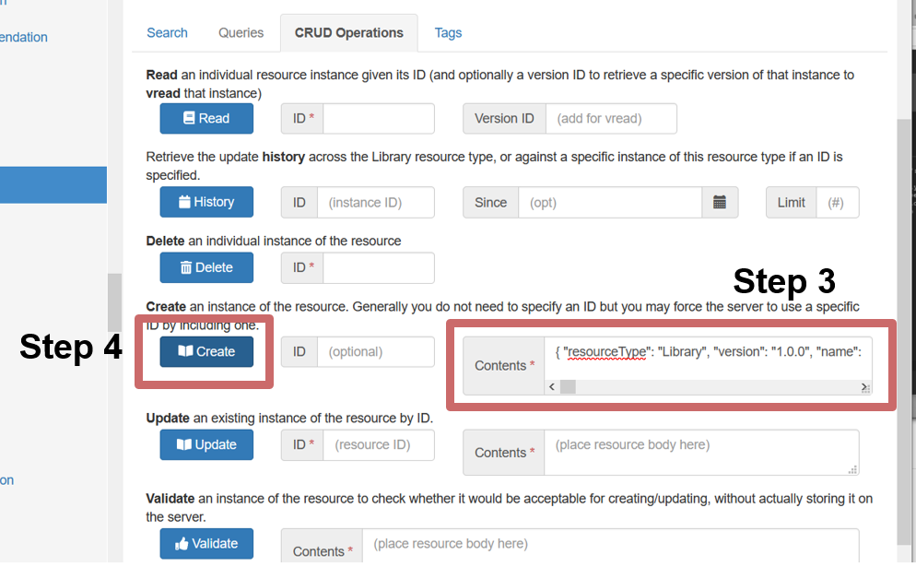
Upload CQL Library to Hapi FHIR
Copy and paste your FHIR Library Resource containing your encoded cql file into the Contents field
Click on Create

Slide 11
CQL Resources
CQL basic code detailed explanation: https://www.youtube.com/watch?v=NJHi5ylxSwo&ab_channel=DevDays
Useful CQL examples repository: https://github.com/cqframework/CQL-Formatting-and-Usage-Wiki/wiki/Cooking-with-CQL-Examples
CQL Runner repository: https://github.com/DBCG/cql_runner/blob/master/README.md

